Slide 1
Crop Production Analysis in India

Slide 2
Introduction
The agricultural sector in India plays a critical role in ensuring food security for a growing population. However, traditional farming methods are often resource-intensive and struggle to keep pace with rising demand. This presentation explores the potential of big data analytics to revolutionize crop production in India. We'll analyze a vast dataset on crop production spanning several years, aiming to predict future yields and identify key factors influencing crop success. By leveraging big data, we can empower Indian farmers to make informed decisions and optimize their agricultural practices for a more sustainable and abundant future.

Slide 3
Details Of Data
The data for this analysis would encompass a vast dataset on crop production in India over several years. This dataset could include information from various sources:
StateName, District name, Crop year, Season, Area, Production

Slide 4
1 Sum of production by year 2 Average yield and sum of production 3 sum of production by state name 4 sum of production by state name and season 5 sum of area 6 Sum of production
Main KPIs
”

Slide 5
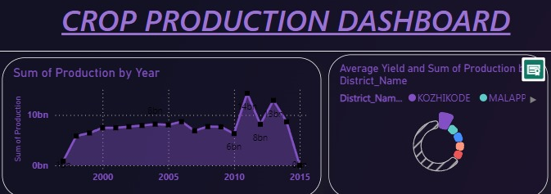
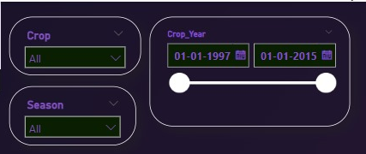
My Dashboard

Slide 6
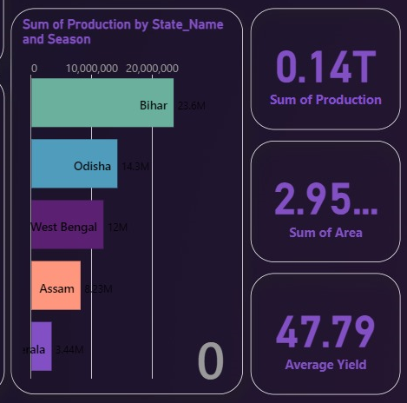
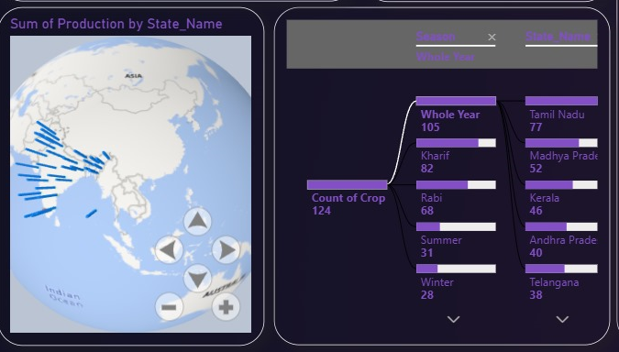
My Dashboard

Slide 7
Thank you

